Slide 1
CGT 575 Data Visualization Tools & Applications
Week 6
Spring 2023
Thursday, February 16, 2023

Slide 2
Why Dashboards?
What are some scenarios where dashboards are useful?

Slide 3
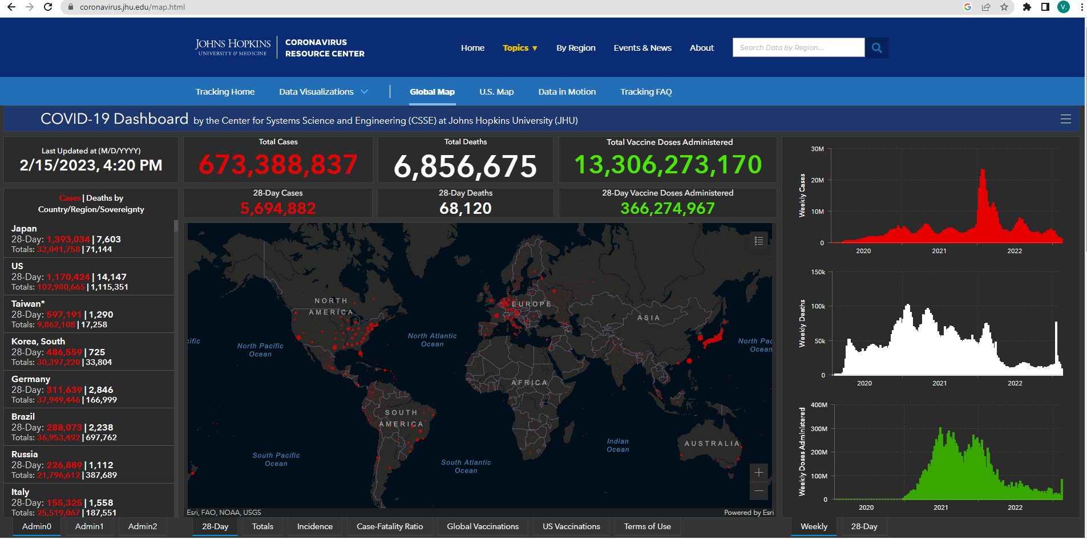
COVID-19 DASHBOARD Johns Hopkins

Slide 4
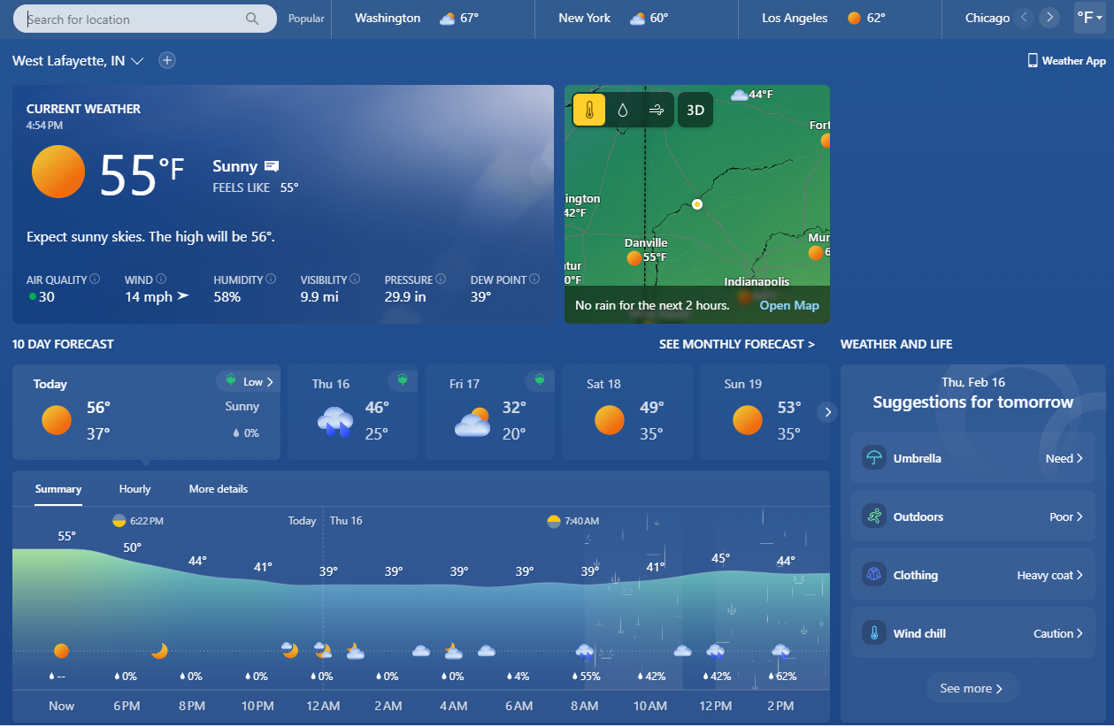

Slide 5
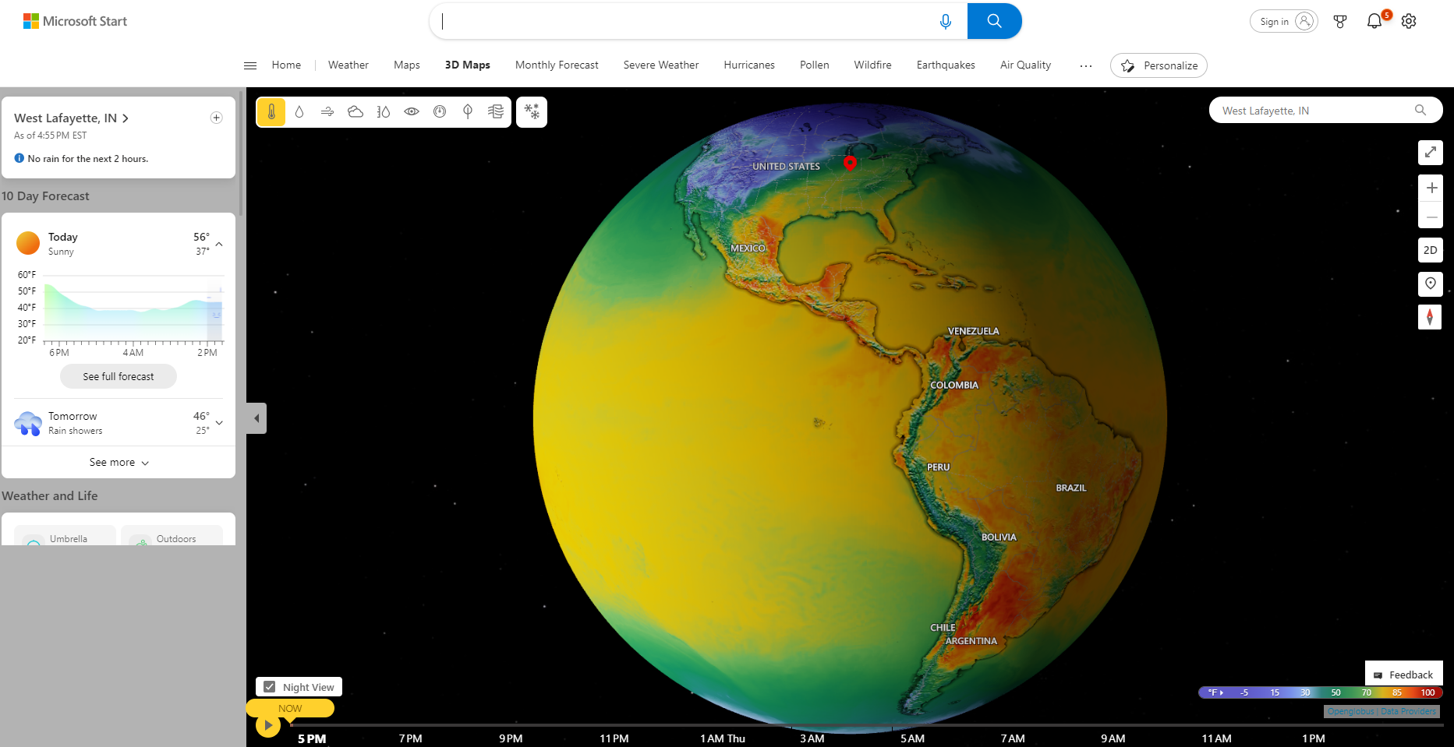

Slide 6
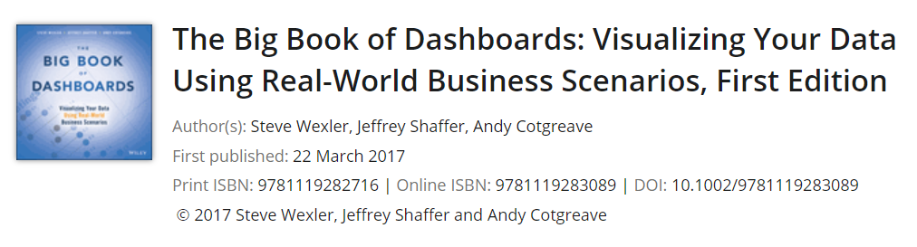

Slide 7
For Educational Purposes Only
DO NOT post to Brightspace
Students have access via the Purdue Online Library catalog

Slide 8
The Scenarios
Course Metrics Dashboard
Comparing Individual Performance with Peers
What-if Analysis: Wage Increase Ramifications
Executive Sales Dashboard
Ranking by Now, Comparing with Then
Are We on Pace to Reach our Goals?
Multiple Key Performance Metrics
Power Plan Operations Monitoring
Showing Year-to-Date and Year-over-Year at the Same Time
Premier League Player Performance Metrics
RSB 6 Nations Championship Match Performance Analysis
Web Analytics
Wexler, Steve, Jeffrey Shaffer, and Andy Cotgreave. The Big Book of Dashboards : Visualizing Your Data Using Real-World Business Scenarios. Hoboken, New Jersey: Wiley, 2017.

Slide 9
The Scenarios
Patient History Analysis of Recent Hospital Admissions
Hospitality Dashboard for Hotel Management
Sentiment Analysis: Showing Overall Distribution
Showing Sentiment with Net Promoter Score
Server Process Monitoring
Big Mac Index
Complaints Dashboard
Hospital Operating Room Utilization
Showing Rank and Magnitude
Measuring Claims across Multiple Measures and Dimensions
Showing Churn or Turnover
Showing Actual versus Potential Utilization
Wexler, Steve, Jeffrey Shaffer, and Andy Cotgreave. The Big Book of Dashboards : Visualizing Your Data Using Real-World Business Scenarios. Hoboken, New Jersey: Wiley, 2017.

Slide 10
The Scenarios
Health Care Provider Productivity Monitoring
Telecom Operator Executive Dashboard
Economy at a Glance
Call Center
Wexler, Steve, Jeffrey Shaffer, and Andy Cotgreave. The Big Book of Dashboards : Visualizing Your Data Using Real-World Business Scenarios. Hoboken, New Jersey: Wiley, 2017.

Slide 11
What’s the Scenario?
The Big Picture
Specifics
Related Scenarios
How People Will Use the Dashboard

Slide 12
Course Metrics Dashboard
Dashboard Designer: Jeffrey A. Shaffer
Organization: University of Cincinnati
Wexler, Steve, Jeffrey Shaffer, and Andy Cotgreave. The Big Book of Dashboards : Visualizing Your Data Using Real-World Business Scenarios. Hoboken, New Jersey: Wiley, 2017.

Slide 13
Big Picture
You are a professor at a university or the head of an academic department.
You want to know how a particular professor's course is rated compared to others in the department and the college.
You want to know the overall course load, the number of students, and the overall growth or decline of a particular course.
You also want to be able to see the rating comparing one specific course against all of the courses in the department and in the college.
Wexler, Steve, Jeffrey Shaffer, and Andy Cotgreave. The Big Book of Dashboards : Visualizing Your Data Using Real-World Business Scenarios. Hoboken, New Jersey: Wiley, 2017.

Slide 14
Q: What do you need to know?

Slide 15
Specifics
You need to see how many courses an instructor has been teaching over time.
You need to see how many students are registering for the classes.
You want to see the trend over a specific period of time.
This might be the entire span of the course (as shown in the overview dashboard), or it may be a rolling period of time, for example, the last five years.
You would like to see the detailed ratings of the most recent course and instructor feedback.
You need to be able to quickly compare this course and instructor to other courses in the department and the college.
Wexler, Steve, Jeffrey Shaffer, and Andy Cotgreave. The Big Book of Dashboards : Visualizing Your Data Using Real-World Business Scenarios. Hoboken, New Jersey: Wiley, 2017.

Slide 16
Q: Can you think of any other scenarios?
Where you could collect similar types of data for a dashboard

Slide 17
Related Scenarios
You conduct workshops or seminars and need to see ratings for these offerings.
You conduct training programs at your company on various topics and need to track sign-ups and feedback for a particular topic or presenter.
You want to track cohort size and performance over time and see the performance detail of the most recent cohort.
You want to track reviews of your product or service, how many people have completed reviews, the ratings over time, and the details of the most recent reviews on, say, Amazon or Yelp.
You want to see how sales in your department compare to sales in other departments or store averages.
Wexler, Steve, Jeffrey Shaffer, and Andy Cotgreave. The Big Book of Dashboards : Visualizing Your Data Using Real-World Business Scenarios. Hoboken, New Jersey: Wiley, 2017.

Slide 18
Course Metrics Dashboard
Dashboard Designer: Jeffrey A. Shaffer
Organization: University of Cincinnati
Wexler, Steve, Jeffrey Shaffer, and Andy Cotgreave. The Big Book of Dashboards : Visualizing Your Data Using Real-World Business Scenarios. Hoboken, New Jersey: Wiley, 2017.

Slide 19
Course Metrics Dashboard
This dashboard shows the course history for the Data Visualization class at the University of Cincinnati.
The course is taught by Jeffrey Shaffer in the Carl H. Lindner College of Business and is part of the operations, business analytics, and information systems department.
Courses are registered under their discipline within the department.
OM—Operations Management
BANA—Business Analytics
IS—Information Systems
Wexler, Steve, Jeffrey Shaffer, and Andy Cotgreave. The Big Book of Dashboards : Visualizing Your Data Using Real-World Business Scenarios. Hoboken, New Jersey: Wiley, 2017.

Slide 20
How People Use the Dashboard
The course number used in this dashboard is BANA6037, which is the same from semester to semester.
A semester indicator and section ID are then used to distinguish the classes.
001 indicates the first section for Fall Semester 2016 and 002 is the second section.
Wexler, Steve, Jeffrey Shaffer, and Andy Cotgreave. The Big Book of Dashboards : Visualizing Your Data Using Real-World Business Scenarios. Hoboken, New Jersey: Wiley, 2017.

Slide 21
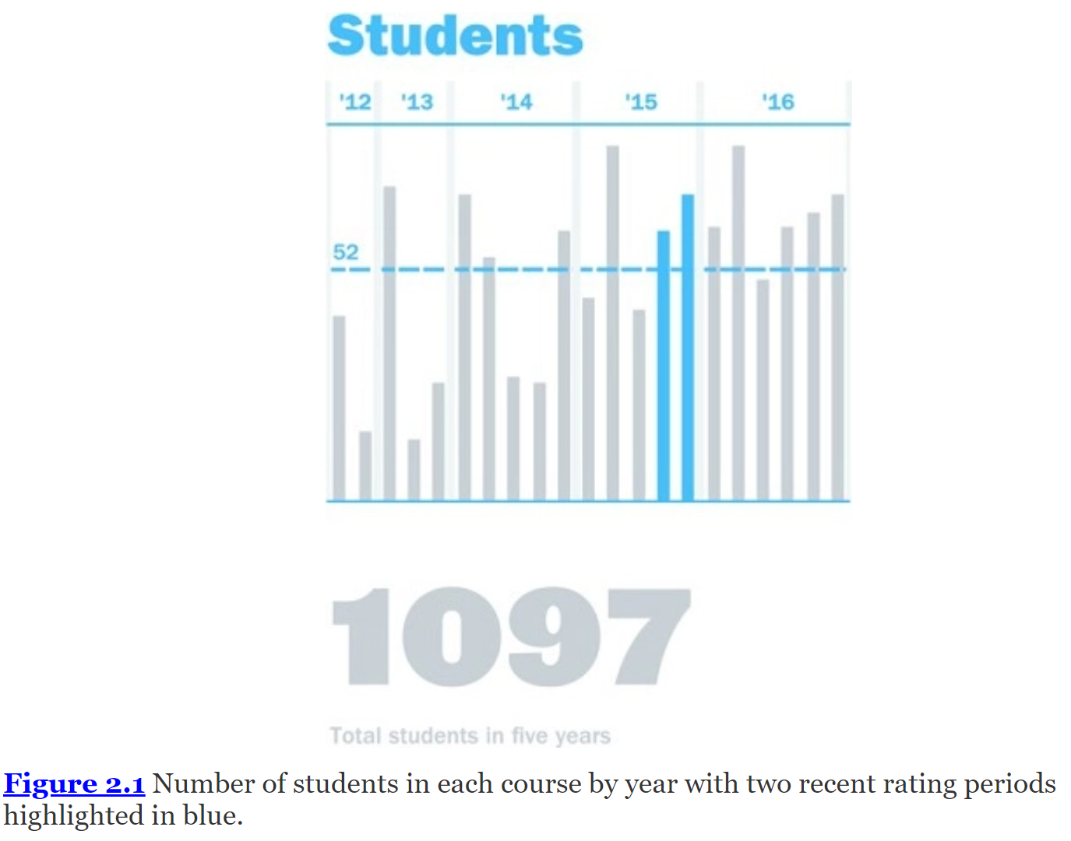
How People Use the Dashboard
The dashboard begins with a general overview of BANA6037.
It shows the entire history of the course, which began in Spring Semester 2012.
Figure 2.1 shows the number of students in each class over time.
Wexler, Steve, Jeffrey Shaffer, and Andy Cotgreave. The Big Book of Dashboards : Visualizing Your Data Using Real-World Business Scenarios. Hoboken, New Jersey: Wiley, 2017.

Slide 22
How People Use the Dashboard
This chart indicates the class size for each individual class, which is very important for a number of reasons.
Wexler, Steve, Jeffrey Shaffer, and Andy Cotgreave. The Big Book of Dashboards : Visualizing Your Data Using Real-World Business Scenarios. Hoboken, New Jersey: Wiley, 2017.

Slide 23
How People Use the Dashboard
Should the college keep offering the class? Success of a course can be measured by answering two questions:
Are people signing up for the class?
Are students rating the class well?
Wexler, Steve, Jeffrey Shaffer, and Andy Cotgreave. The Big Book of Dashboards : Visualizing Your Data Using Real-World Business Scenarios. Hoboken, New Jersey: Wiley, 2017.

Slide 24
How People Use the Dashboard
This chart highlights the demand growth for the course.
This particular class is an elective for the degree programs, so if no one were signing up for the course, then it wouldn't make sense to keep offering it.
Wexler, Steve, Jeffrey Shaffer, and Andy Cotgreave. The Big Book of Dashboards : Visualizing Your Data Using Real-World Business Scenarios. Hoboken, New Jersey: Wiley, 2017.

Slide 25
How People Use the Dashboard
Each course has a registration capacity.
If demand is growing, then there may be a need to offer additional courses in the future, which is the case in this example.
Wexler, Steve, Jeffrey Shaffer, and Andy Cotgreave. The Big Book of Dashboards : Visualizing Your Data Using Real-World Business Scenarios. Hoboken, New Jersey: Wiley, 2017.

Slide 26
How People Use the Dashboard
Lecture halls have strict seating capacities based on fire code rules.
Understanding course demand is critical in planning the course capacity and determining whether a course needs to be moved to a different lecture hall for additional seats to open.
Wexler, Steve, Jeffrey Shaffer, and Andy Cotgreave. The Big Book of Dashboards : Visualizing Your Data Using Real-World Business Scenarios. Hoboken, New Jersey: Wiley, 2017.

Slide 27
How People Use the Dashboard
A reference line is used to show the average class size.
This line helps illustrate the growth of the classes in the most recent semesters versus the earlier classes from 2012 and 2013.
Wexler, Steve, Jeffrey Shaffer, and Andy Cotgreave. The Big Book of Dashboards : Visualizing Your Data Using Real-World Business Scenarios. Hoboken, New Jersey: Wiley, 2017.

Slide 28
How People Use the Dashboard
A number of other alternatives could be used in this case, including:
Comparing the average class size for the department to the classes.
Comparing the average class size of the college to these classes.
Using a bullet chart, with a target line on each bar chart, showing the course capacity.
This would give an indication of how many open seats were available from semester to semester and could provide an indicator if a course was over capacity.
Wexler, Steve, Jeffrey Shaffer, and Andy Cotgreave. The Big Book of Dashboards : Visualizing Your Data Using Real-World Business Scenarios. Hoboken, New Jersey: Wiley, 2017.

Slide 29
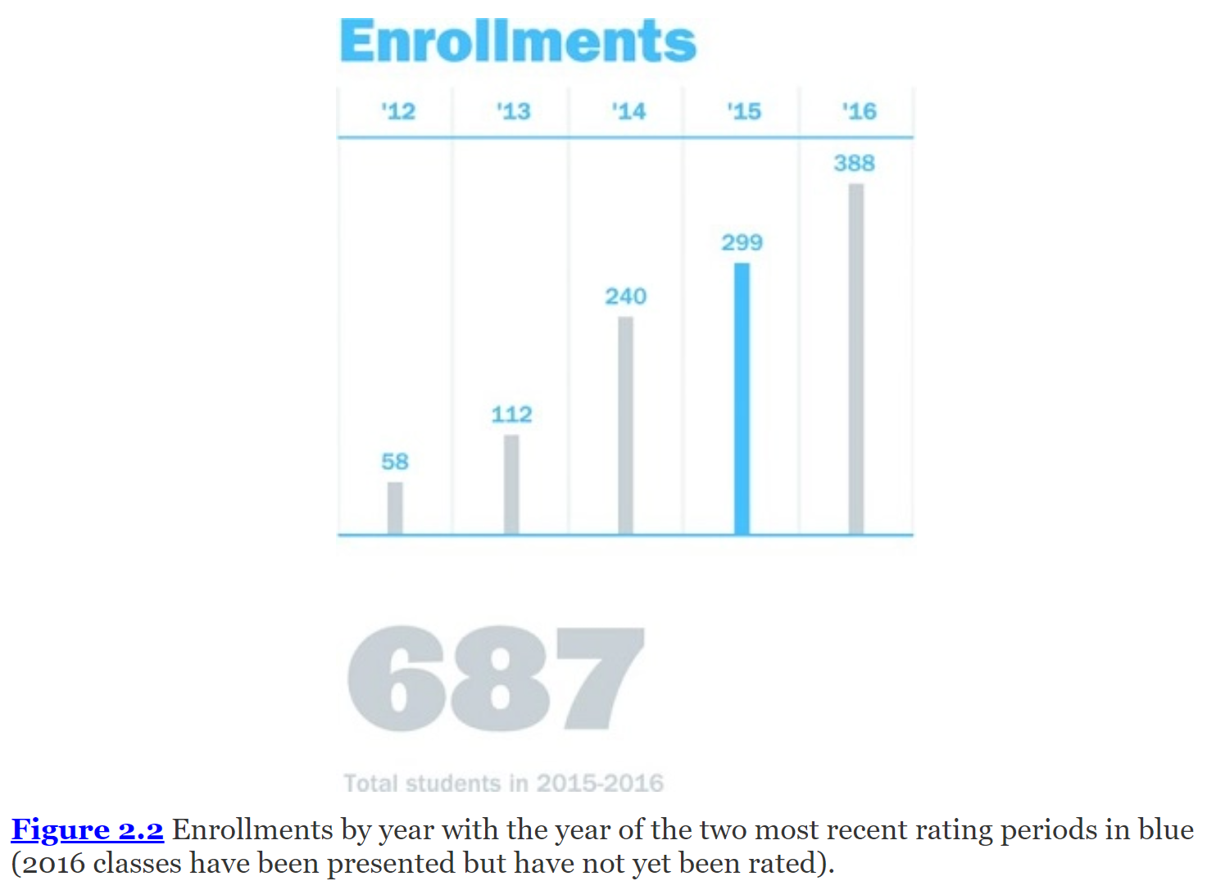
How People Use the Dashboard
Figure 2.2 shows the enrollments by year.
This is similar to the chart in Figure 2.1 but summarizes the enrollment by calendar year.
Wexler, Steve, Jeffrey Shaffer, and Andy Cotgreave. The Big Book of Dashboards : Visualizing Your Data Using Real-World Business Scenarios. Hoboken, New Jersey: Wiley, 2017.

Slide 30
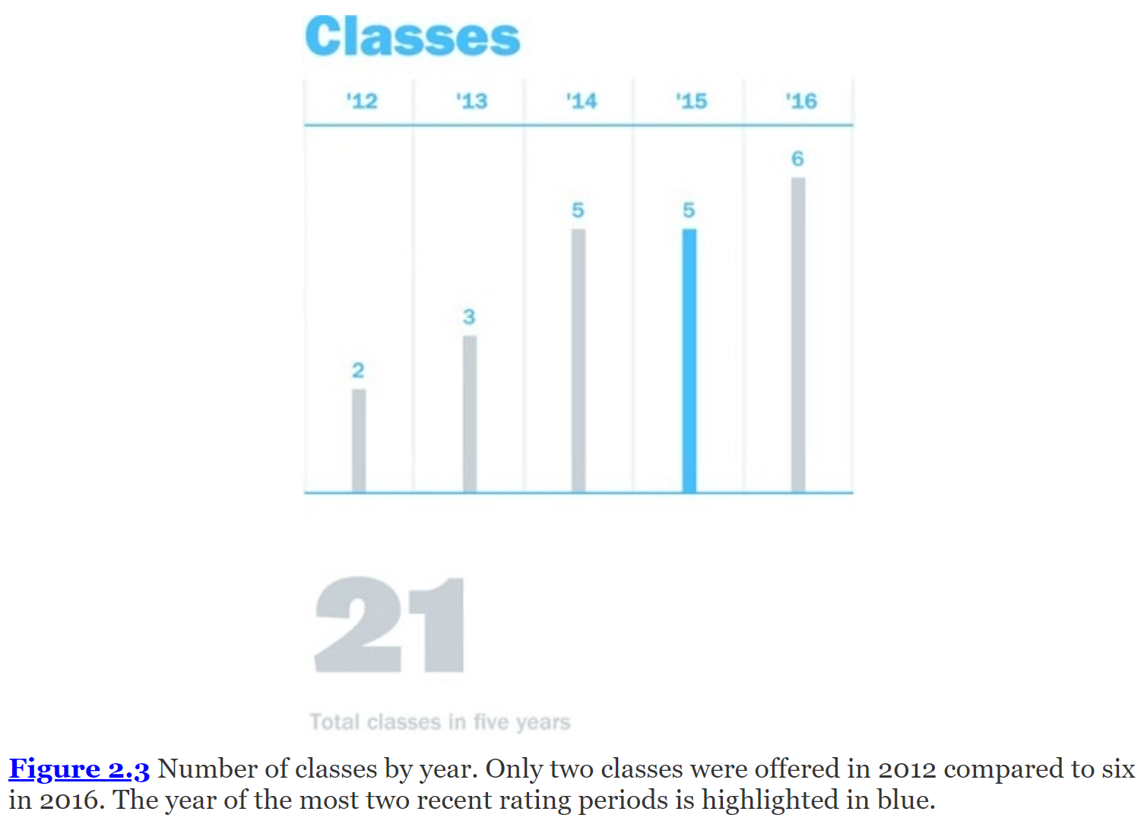
Course Metrics Dashboard
This particular example highlights the growth of the last two years.
That is, there are 1,097 totals students in five years but 687 in 2015–2016.
Figure 2.3 gives additional context as to why that is the case and shows the number of classes over time, which gives additional context to the large growth in the number of students.
Wexler, Steve, Jeffrey Shaffer, and Andy Cotgreave. The Big Book of Dashboards : Visualizing Your Data Using Real-World Business Scenarios. Hoboken, New Jersey: Wiley, 2017.

Slide 31
Course Metrics Dashboard
Figure 2.3 highlights an important part of the data:
For example, do we simply have more students because the class size grew from a 25-person classroom to a 220-seat auditorium?
In this case, the answer is no.
Although the class size did grow some, it didn't grow that much.
Rather, the biggest growth came from the number of classes, which grew from two classes in 2012 to six classes for 2016.
Wexler, Steve, Jeffrey Shaffer, and Andy Cotgreave. The Big Book of Dashboards : Visualizing Your Data Using Real-World Business Scenarios. Hoboken, New Jersey: Wiley, 2017.

Slide 32
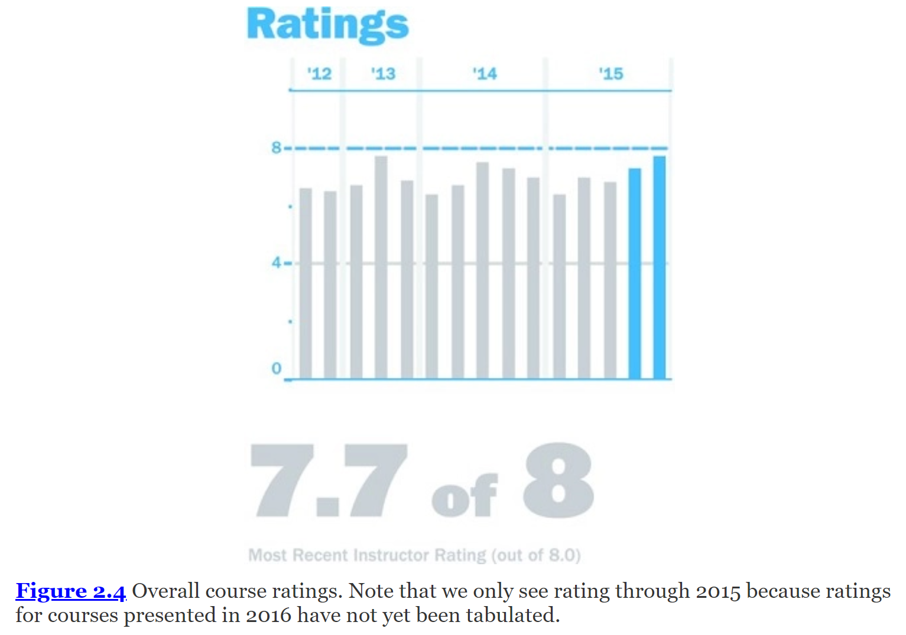
Course Metrics Dashboard
Figure 2.4 gives the overall course rating for each course semester by semester.
Wexler, Steve, Jeffrey Shaffer, and Andy Cotgreave. The Big Book of Dashboards : Visualizing Your Data Using Real-World Business Scenarios. Hoboken, New Jersey: Wiley, 2017.

Slide 33
Course Metrics Dashboard
The course feedback is filled out by the students and is voluntary.
A series of standard questions is asked regarding every course using a rating on a scale of 1 to 8 and an opportunity for comments.
These ratings and feedback are used by the department heads and college to monitor course performance.
For example, if a course is rated excellent and also has at least a 50 percent response rate from students, the professor is named to the “Dean's List of Teaching Excellence” for the semester.
Wexler, Steve, Jeffrey Shaffer, and Andy Cotgreave. The Big Book of Dashboards : Visualizing Your Data Using Real-World Business Scenarios. Hoboken, New Jersey: Wiley, 2017.

Slide 34
Course Metrics Dashboard
In some rating systems, there is a constant target set by an internal benchmark.
In other rating systems, the target moves from rating period to rating period;
for example, the benchmark may be set based on the average in the current period or the previous period.
Regardless of how it's calculated, a target line can add context to the data.
Wexler, Steve, Jeffrey Shaffer, and Andy Cotgreave. The Big Book of Dashboards : Visualizing Your Data Using Real-World Business Scenarios. Hoboken, New Jersey: Wiley, 2017.

Slide 35
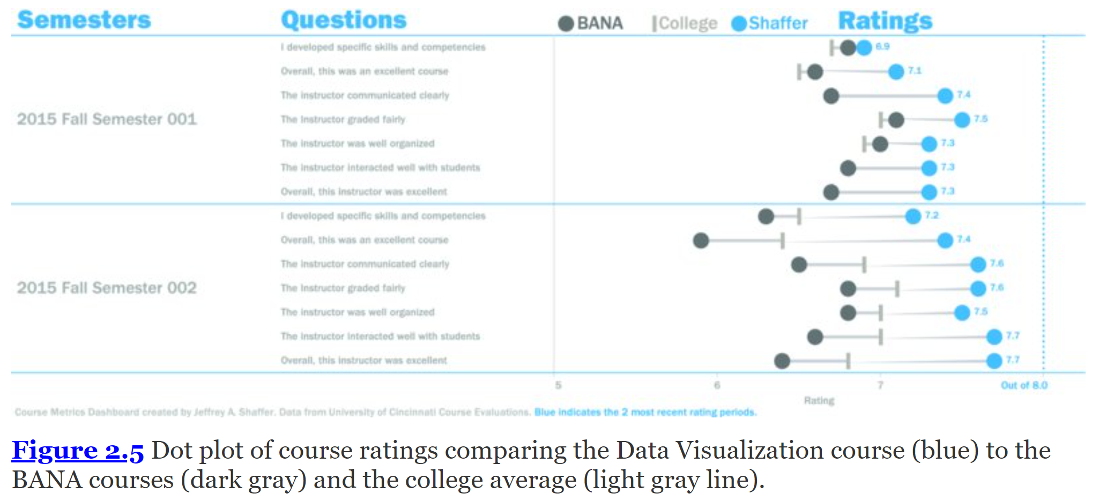
Course Metrics Dashboard
I developed specific skills and competencies
Overall, this was an excellent course
The instructor graded fairly
The instructor was well organized
The instructor interacted well with students
Overall, this instructor was excellent
The dot plot on the bottom section of the dashboard, shown in Figure 2.5, provides a detailed comparison for each of the questions asked on the course evaluation survey.
I developed specific skills and competencies
Overall, this was an excellent course
The instructor communicated clearly
The instructor graded fairly
The instructor was well organized
The instructor interacted well with students
Overall, this instructor was excellent
I developed specific skills and competencies
Overall, this was an excellent course
The instructor communicated clearly
The instructor graded fairly
The instructor was well organized
The instructor interacted well with students
Overall, this instructor was excellent
Wexler, Steve, Jeffrey Shaffer, and Andy Cotgreave. The Big Book of Dashboards : Visualizing Your Data Using Real-World Business Scenarios. Hoboken, New Jersey: Wiley, 2017.

Slide 36
Course Metrics Dashboard
The dark gray dot shows the rating for all courses in the department, listed as “BANA,” and a light gray vertical line indicates the rating for all of the courses in the rating period for the entire college. The blue dot indicates the rating for BANA6037, the particular course selected for comparison. All of these ratings are on a scale of 1 to 8.
I developed specific skills and competencies
Overall, this was an excellent course
The instructor communicated clearly
The instructor graded fairly
The instructor was well organized
The instructor interacted well with students
Overall, this instructor was excellent
I developed specific skills and competencies
Overall, this was an excellent course
The instructor communicated clearly
The instructor graded fairly
The instructor was well organized
The instructor interacted well with students
Overall, this instructor was excellent
Wexler, Steve, Jeffrey Shaffer, and Andy Cotgreave. The Big Book of Dashboards : Visualizing Your Data Using Real-World Business Scenarios. Hoboken, New Jersey: Wiley, 2017.

Slide 37
Course Metrics Dashboard
Notice that the axis for the rating does not start at zero. This makes sense because the values are within a small range of each other, and those differences within the small range matter.
I developed specific skills and competencies
Overall, this was an excellent course
The instructor communicated clearly
The instructor graded fairly
The instructor was well organized
The instructor interacted well with students
Overall, this instructor was excellent
I developed specific skills and competencies
Overall, this was an excellent course
The instructor communicated clearly
The instructor graded fairly
The instructor was well organized
The instructor interacted well with students
Overall, this instructor was excellent
Wexler, Steve, Jeffrey Shaffer, and Andy Cotgreave. The Big Book of Dashboards : Visualizing Your Data Using Real-World Business Scenarios. Hoboken, New Jersey: Wiley, 2017.

Slide 38
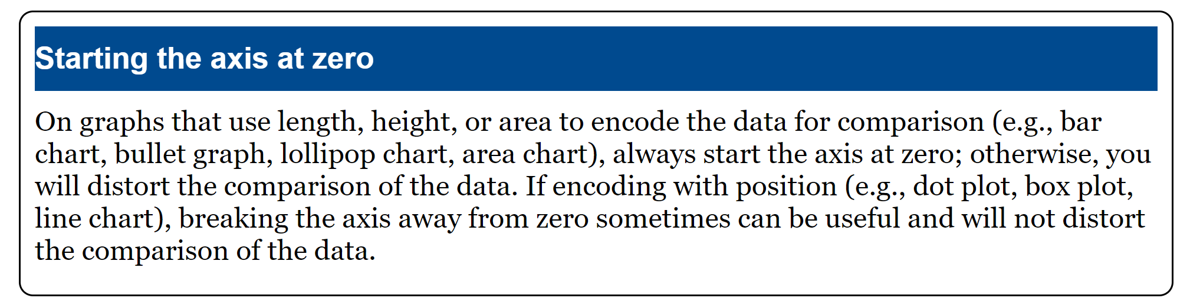
Wexler, Steve, Jeffrey Shaffer, and Andy Cotgreave. The Big Book of Dashboards : Visualizing Your Data Using Real-World Business Scenarios. Hoboken, New Jersey: Wiley, 2017.

Slide 39
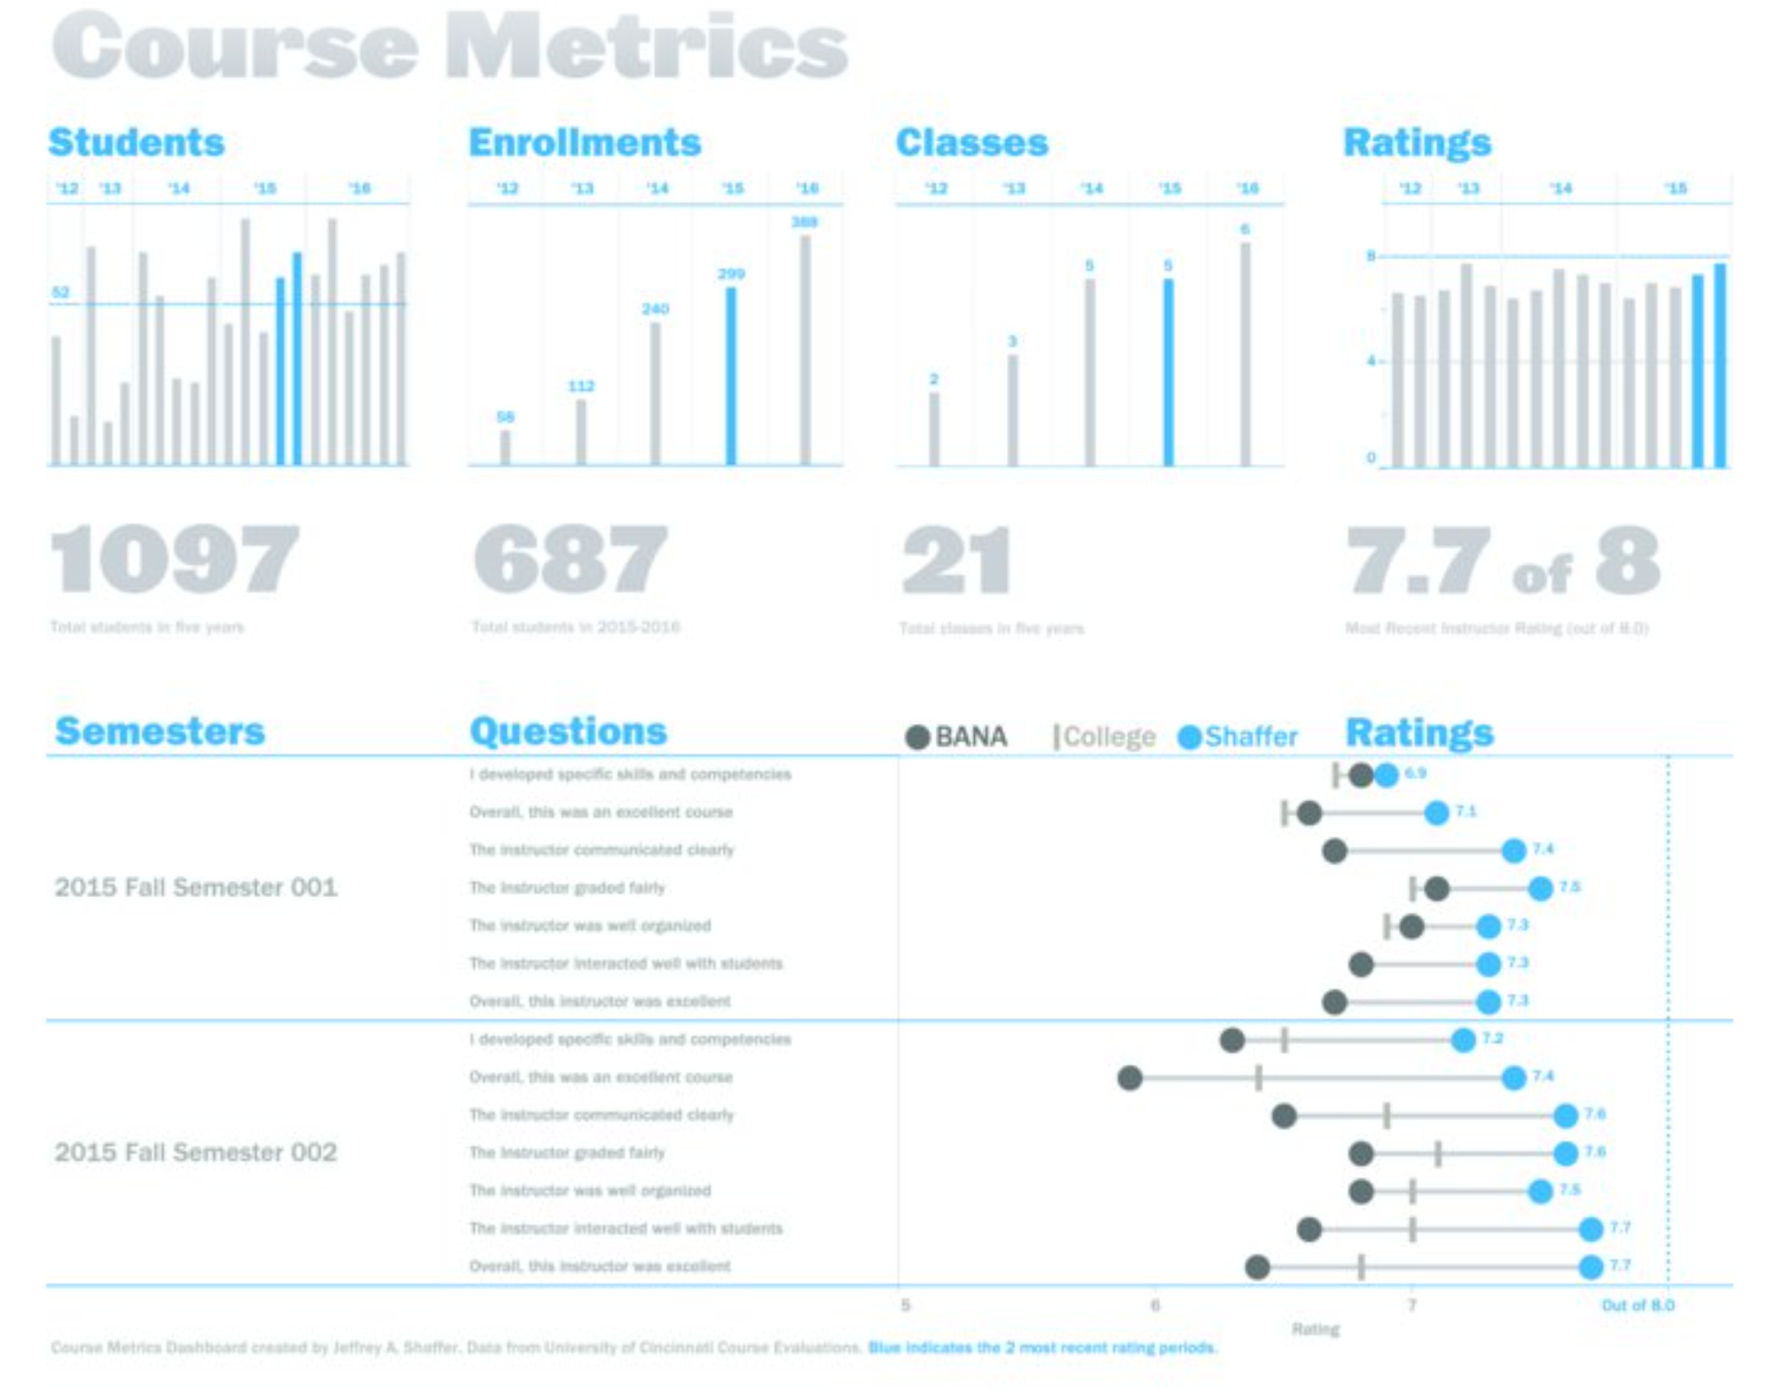
Wexler, Steve, Jeffrey Shaffer, and Andy Cotgreave. The Big Book of Dashboards : Visualizing Your Data Using Real-World Business Scenarios. Hoboken, New Jersey: Wiley, 2017.

Slide 40
Why This Works
Easy-to-See Key Metrics
Simple Color Scheme
Potential to be Static or Interactive
Both Overview and Details are Clear
Wexler, Steve, Jeffrey Shaffer, and Andy Cotgreave. The Big Book of Dashboards : Visualizing Your Data Using Real-World Business Scenarios. Hoboken, New Jersey: Wiley, 2017.

Slide 41
The Traditional Approach and Why You Should Avoid It

Slide 42
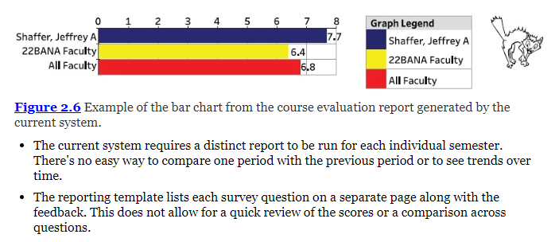
Problems with Figure 2.6
Wexler, Steve, Jeffrey Shaffer, and Andy Cotgreave. The Big Book of Dashboards : Visualizing Your Data Using Real-World Business Scenarios. Hoboken, New Jersey: Wiley, 2017.

Slide 43
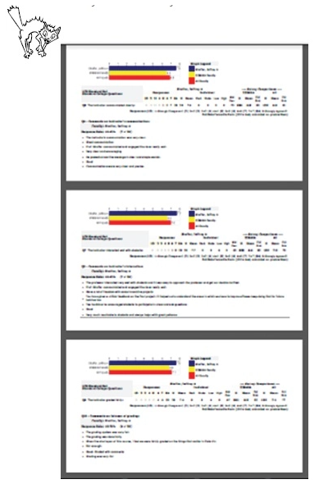

Problems with Figure 2.7
The graphical representation is a bar chart on a fixed axis.
Although this encoding of the data works, it hides the small differences in the scale of the ratings.
As an example, it's very hard to see the difference between 6.4 and 6.8 on the bar chart.
The colors are bright and alerting.
Bright yellow and bright red are being used to show a standard categorical color.
Wexler, Steve, Jeffrey Shaffer, and Andy Cotgreave. The Big Book of Dashboards : Visualizing Your Data Using Real-World Business Scenarios. Hoboken, New Jersey: Wiley, 2017.

Slide 44
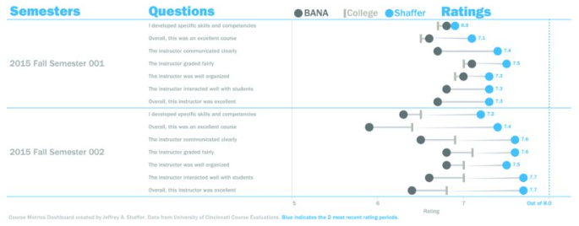
Author Commentary
JEFF: I chose to label the dot plot (see Figure 2.5.) with only the rating for the course. By doing this, I avoided over labeling the dot plot with every point. In an interactive version of the dashboard, a descriptive tool tip could be used that would provide detailed information about every point when the user hovers over them.
Wexler, Steve, Jeffrey Shaffer, and Andy Cotgreave. The Big Book of Dashboards : Visualizing Your Data Using Real-World Business Scenarios. Hoboken, New Jersey: Wiley, 2017.

Slide 45
Author Commentary
JEFF: Labels could also be moved to the center of the dots. In this particular data set, the granularity of the data required one decimal place. Because of the extra decimal place, moving the labels inside the circles required a much smaller font size or a larger circle, so I chose to place them outside of the circles.
Wexler, Steve, Jeffrey Shaffer, and Andy Cotgreave. The Big Book of Dashboards : Visualizing Your Data Using Real-World Business Scenarios. Hoboken, New Jersey: Wiley, 2017.

Slide 46
Author Commentary
JEFF: One design choice I made was to keep the width of the bars on the bar charts similar from chart to chart (see Figures 2.1, 2.2, 2.3, 2.4). I typically set the width of bar charts to allow approximately 25 to 50 percent of the bar width as spacing between the bars on bar charts (and just a slight space between the bars on histograms).
Wexler, Steve, Jeffrey Shaffer, and Andy Cotgreave. The Big Book of Dashboards : Visualizing Your Data Using Real-World Business Scenarios. Hoboken, New Jersey: Wiley, 2017.

Slide 47
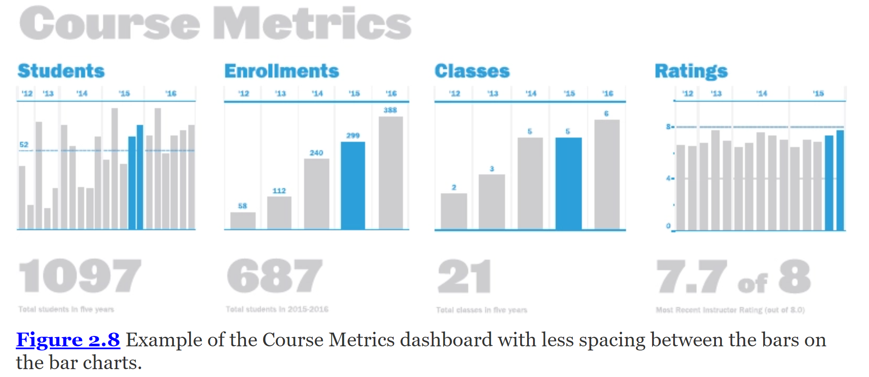
Author Commentary
JEFF: Figure 2.8 shows what this might look like with wider bars. For me, this displays as a bar chart on the two inside charts and more of a lollipop-style chart on the two outside bar charts. Both styles encode the data using length and do not distort the data in any way so I used thinner bars as a style choice for the overall design.
Wexler, Steve, Jeffrey Shaffer, and Andy Cotgreave. The Big Book of Dashboards : Visualizing Your Data Using Real-World Business Scenarios. Hoboken, New Jersey: Wiley, 2017.

Slide 48
Author Commentary
JEFF: Also, I chose the font very carefully in this dashboard. The large font for the title and key metric numbers is Leviathan, showing in a heavier style. The other dashboard text is Franklin Gothic Heavy and Medium, which are used together with Leviathan to achieve three distinct levels and weights of the fonts throughout the dashboard.
Wexler, Steve, Jeffrey Shaffer, and Andy Cotgreave. The Big Book of Dashboards : Visualizing Your Data Using Real-World Business Scenarios. Hoboken, New Jersey: Wiley, 2017.

Slide 49
Author Commentary
JEFF: A special thanks to Darrin Hunter of Dish Design (http://www.dishdesign.com/) for reviewing this dashboard and offering design suggestions. Darrin is a former professor from the University of Cincinnati Design, Architecture, Art and Planning (DAAP) College and now runs his own graphic design company.
STEVE: Jeff's dot plot has become my go-to approach for comparing aggregated results from multiple sources (in this case an individual compared to a peer group compared to the college as a whole).
Wexler, Steve, Jeffrey Shaffer, and Andy Cotgreave. The Big Book of Dashboards : Visualizing Your Data Using Real-World Business Scenarios. Hoboken, New Jersey: Wiley, 2017.

Slide 50
More Dashboards
Online access available via Purdue Online Library catalog

Slide 51
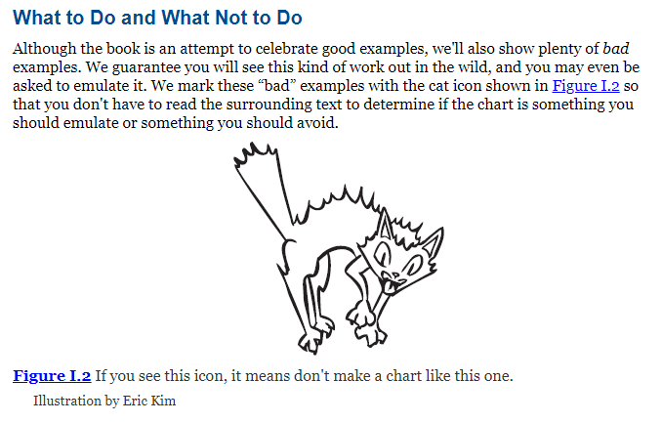
The Big Book of Dashboards
Wexler, Steve, Jeffrey Shaffer, and Andy Cotgreave. The Big Book of Dashboards : Visualizing Your Data Using Real-World Business Scenarios. Hoboken, New Jersey: Wiley, 2017.

Slide 52
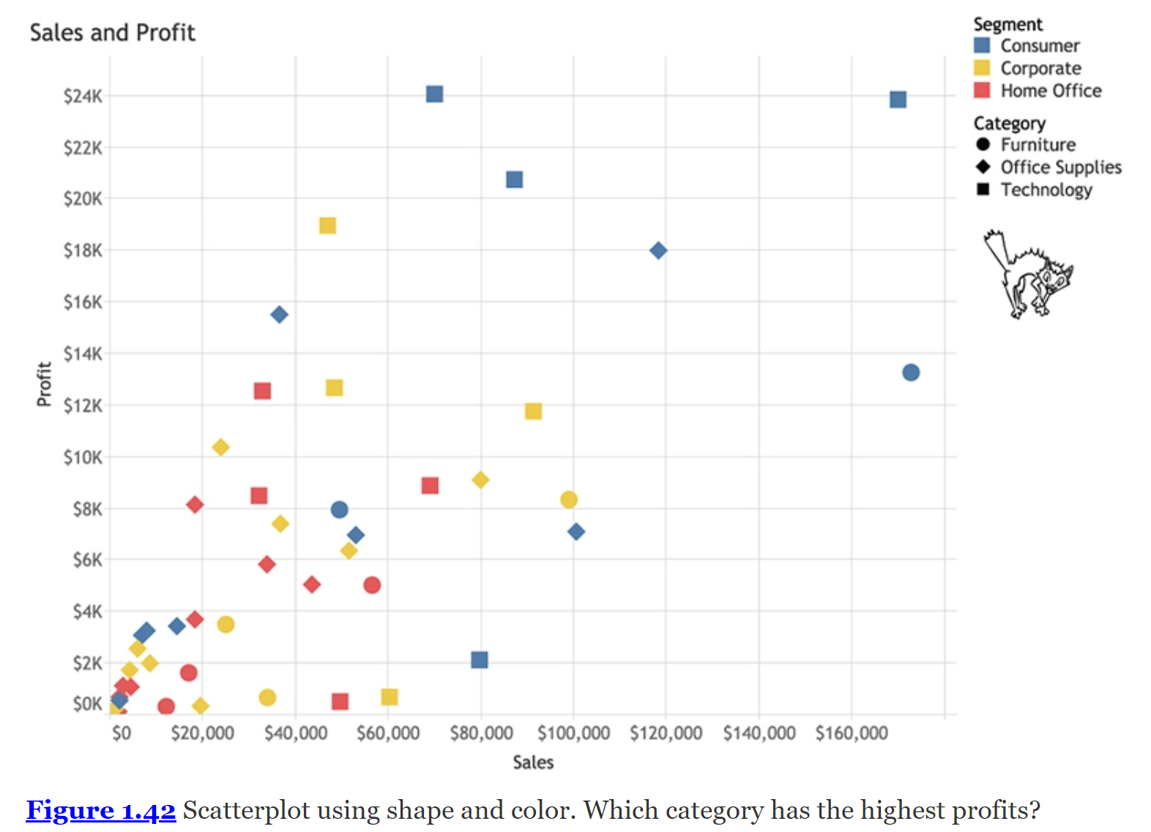
Wexler, Steve, Jeffrey Shaffer, and Andy Cotgreave. The Big Book of Dashboards : Visualizing Your Data Using Real-World Business Scenarios. Hoboken, New Jersey: Wiley, 2017.
Notes:
It's almost impossible to see anything, isn't it? Mixing position, color, and shape does not make for easy reading. What's a better solution?

Slide 53
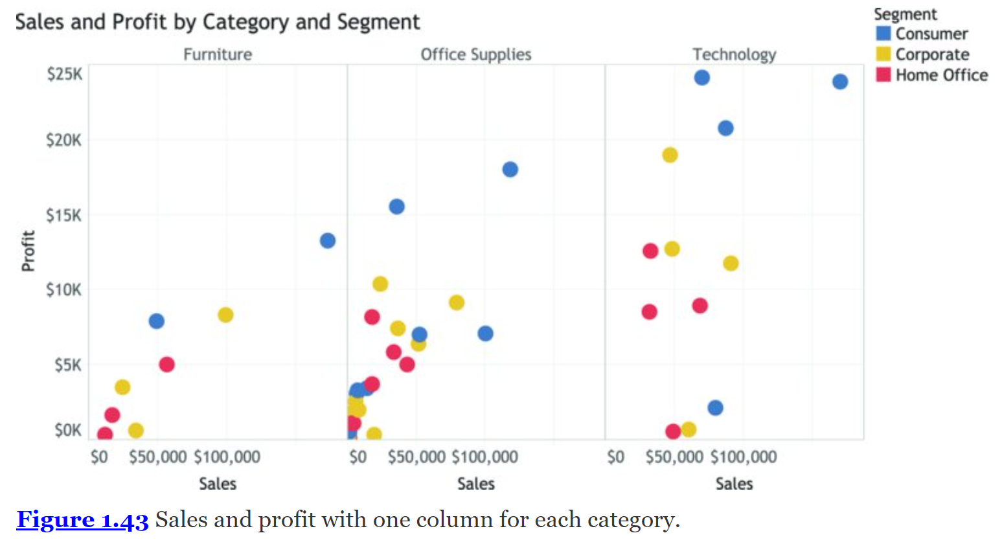
Wexler, Steve, Jeffrey Shaffer, and Andy Cotgreave. The Big Book of Dashboards : Visualizing Your Data Using Real-World Business Scenarios. Hoboken, New Jersey: Wiley, 2017.
Notes:
How about using position to represent category, breaking the single scatterplot into three panels? This is shown in Figure 1.43.
The result is much clearer. Now you can even see that technology sales, on average, have a higher range of profits than furniture and office supplies. That insight was certainly not apparent in the first scatterplot.

Slide 54
let's look at some chart types you might be surprised not to see in our common chart types.
The first is the pie chart.
Sure, it is a common chart, but we do not recommend you use it.
Let's see why pie charts don't play well with our visual system.
Wexler, Steve, Jeffrey Shaffer, and Andy Cotgreave. The Big Book of Dashboards : Visualizing Your Data Using Real-World Business Scenarios. Hoboken, New Jersey: Wiley, 2017.

Slide 55
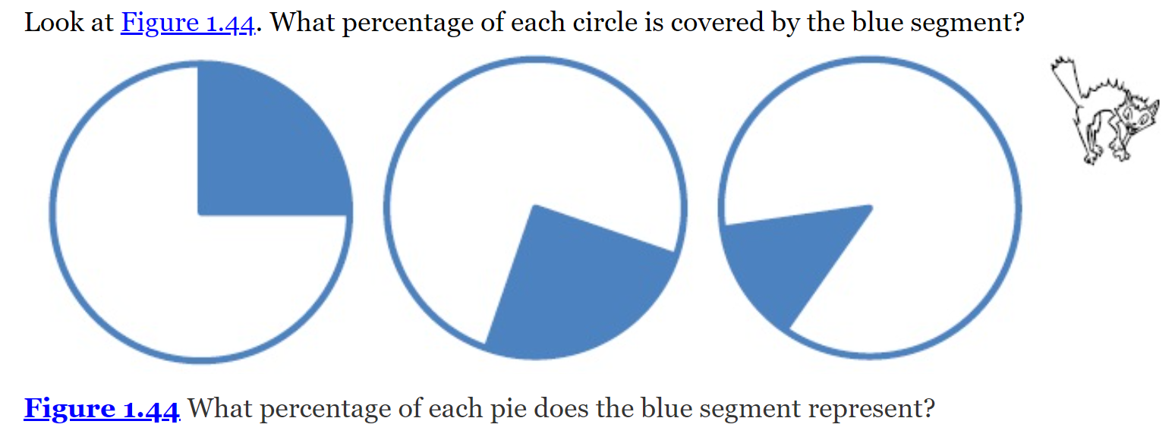
The one on the left is pretty easy: 25 percent.
The middle? It's a little harder. It's also 25 percent, but because it's not aligned to a horizontal or vertical axis, it's harder to determine.
And on the right? It's 13 percent.
How did you do?
We are simply not able to make accurate estimates of angle sizes, and if accurate estimates are the goal, it's a problem.
Wexler, Steve, Jeffrey Shaffer, and Andy Cotgreave. The Big Book of Dashboards : Visualizing Your Data Using Real-World Business Scenarios. Hoboken, New Jersey: Wiley, 2017.
Notes:
The one on the left is pretty easy: 25 percent.
The middle? It's a little harder. It's also 25 percent, but because it's not aligned to a horizontal or vertical axis, it's harder to determine.
And on the right? It's 13 percent.
How did you do?
We are simply not able to make accurate estimates of angle sizes, and if accurate estimates are the goal, it's a problem.

Slide 56
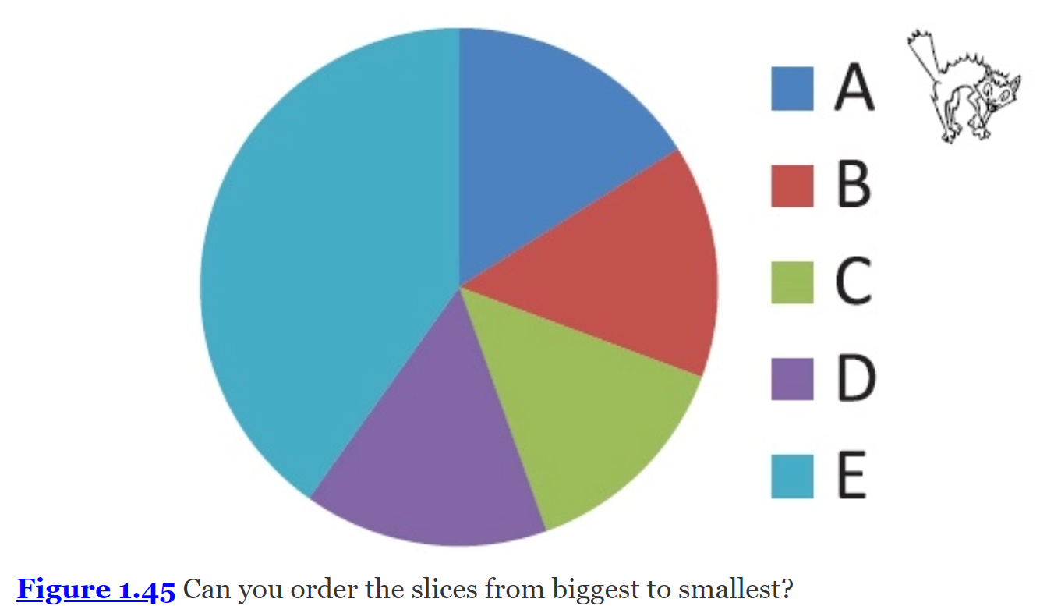
Let’s look at another pie chart
Let's look at another pie.
The biggest slice in Figure 1.45 is easy to spot.
But what about the second, third, and fourth biggest slices?
Wexler, Steve, Jeffrey Shaffer, and Andy Cotgreave. The Big Book of Dashboards : Visualizing Your Data Using Real-World Business Scenarios. Hoboken, New Jersey: Wiley, 2017.

Slide 57
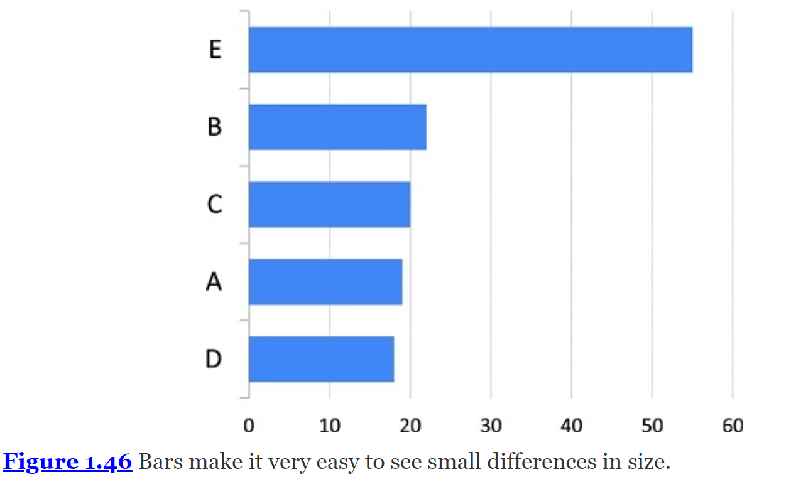
Let’s look at the same data shown in a bar chart
The sorted bar chart made it very easy to distinguish size differences: Length is such an effective visual attribute, we can see very small differences with ease.
Wexler, Steve, Jeffrey Shaffer, and Andy Cotgreave. The Big Book of Dashboards : Visualizing Your Data Using Real-World Business Scenarios. Hoboken, New Jersey: Wiley, 2017.

Slide 58
To make effective dashboards, you must resist the temptation to use purely decorative chart types.
Wexler, Steve, Jeffrey Shaffer, and Andy Cotgreave. The Big Book of Dashboards : Visualizing Your Data Using Real-World Business Scenarios. Hoboken, New Jersey: Wiley, 2017.

Slide 59
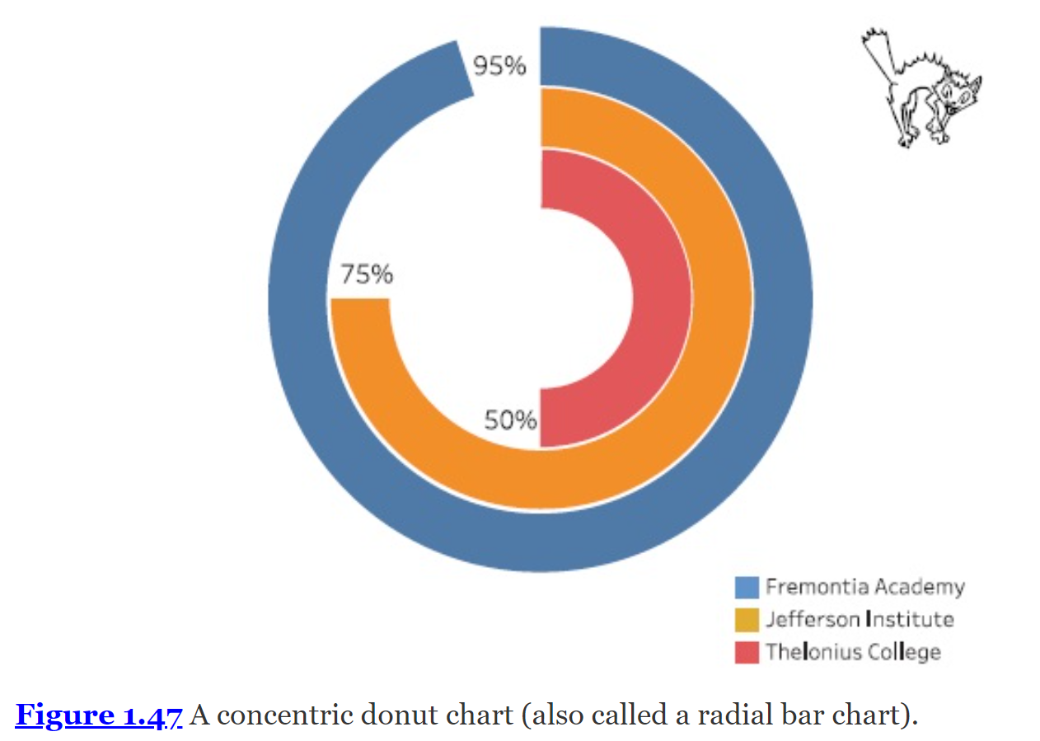
What’s the problem?
Although you may be able to make the comparisons, you are in fact working considerably harder than you need to be.
Wexler, Steve, Jeffrey Shaffer, and Andy Cotgreave. The Big Book of Dashboards : Visualizing Your Data Using Real-World Business Scenarios. Hoboken, New Jersey: Wiley, 2017.

Slide 60
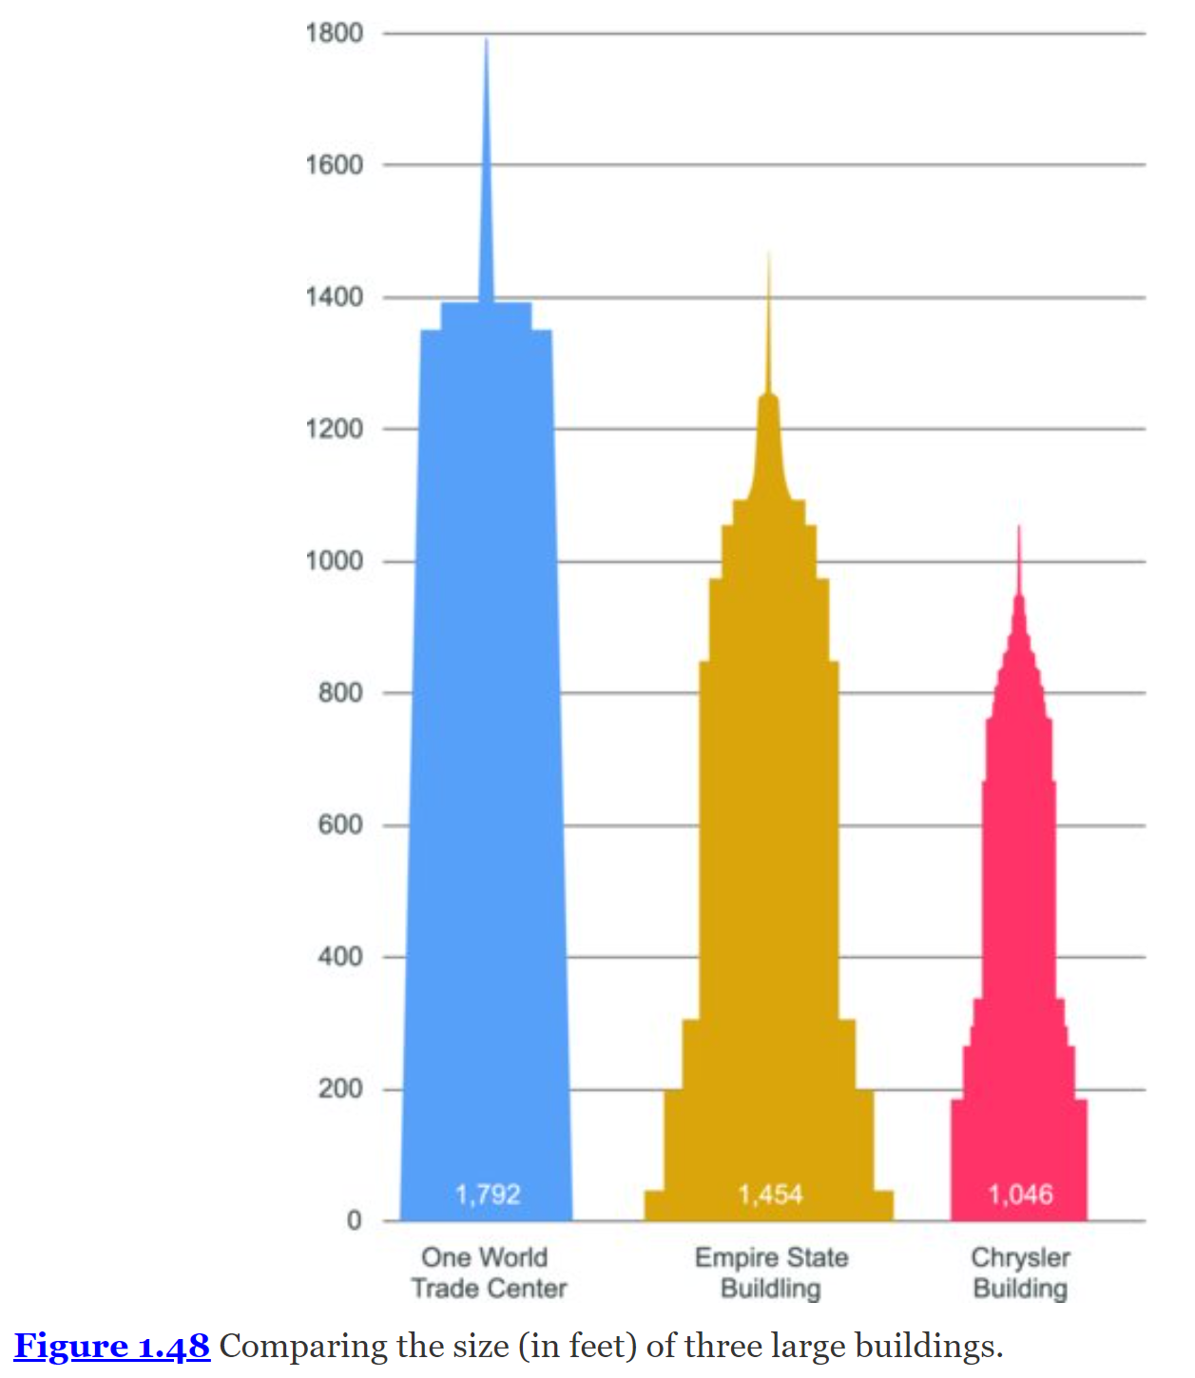
Let's suppose you wanted to compare the heights of three famous buildings:
One World Trade Center,
Empire State Building, and
Chrysler Building.
Wexler, Steve, Jeffrey Shaffer, and Andy Cotgreave. The Big Book of Dashboards : Visualizing Your Data Using Real-World Business Scenarios. Hoboken, New Jersey: Wiley, 2017.

Slide 61
Now, that’s an easy comparison
With virtually no effort, we can see that One World Trade Center (blue) is almost twice as tall as the Chrysler Building (red).
Wexler, Steve, Jeffrey Shaffer, and Andy Cotgreave. The Big Book of Dashboards : Visualizing Your Data Using Real-World Business Scenarios. Hoboken, New Jersey: Wiley, 2017.
Notes:
Now let's see how easy the comparison is with donuts. (See Figure 1.49.)

Slide 62
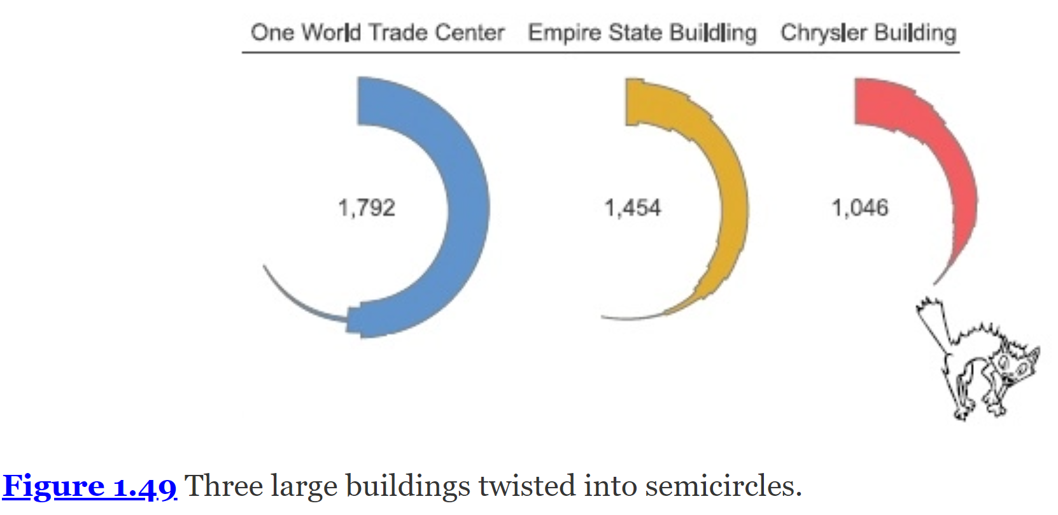
Wexler, Steve, Jeffrey Shaffer, and Andy Cotgreave. The Big Book of Dashboards : Visualizing Your Data Using Real-World Business Scenarios. Hoboken, New Jersey: Wiley, 2017.

Slide 63
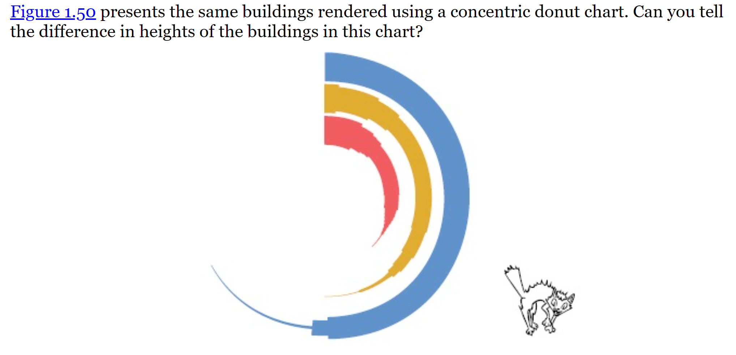
So, with this somewhat contrived but hopefully memorable example, we took something that was simple to compare (the silhouettes of buildings) and contorted them into difficult-to-compare semicircles.
Wexler, Steve, Jeffrey Shaffer, and Andy Cotgreave. The Big Book of Dashboards : Visualizing Your Data Using Real-World Business Scenarios. Hoboken, New Jersey: Wiley, 2017.

Slide 64
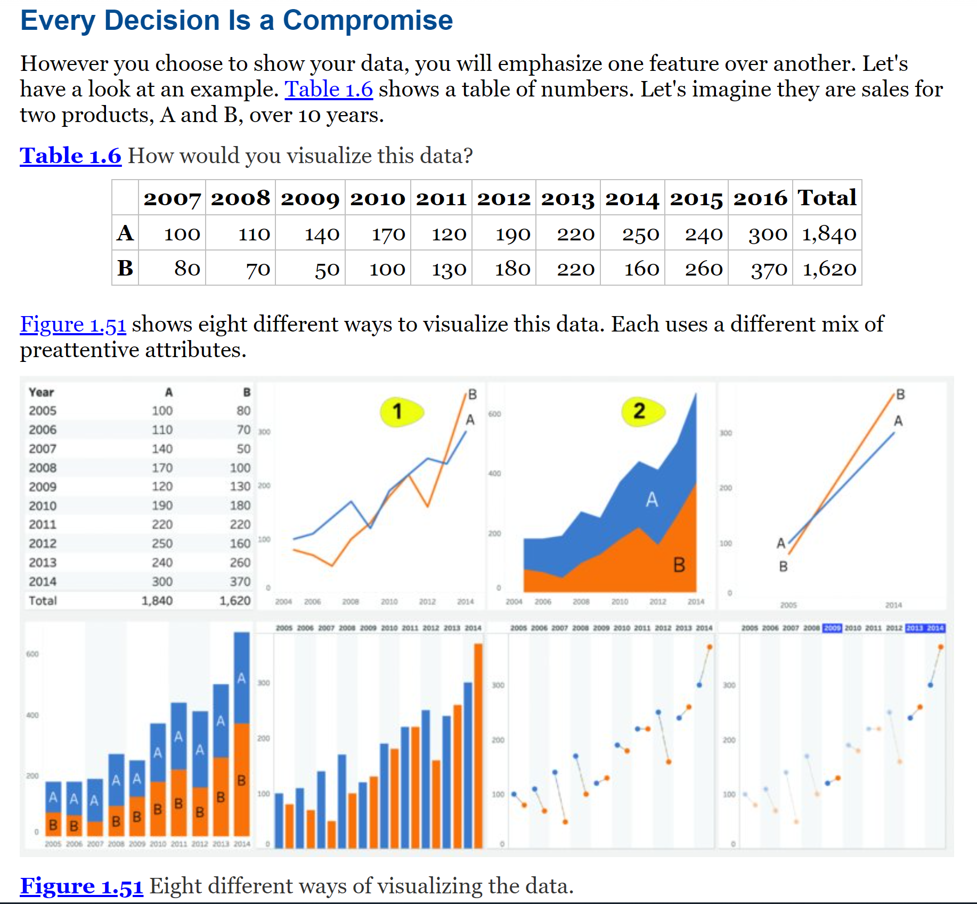
Wexler, Steve, Jeffrey Shaffer, and Andy Cotgreave. The Big Book of Dashboards : Visualizing Your Data Using Real-World Business Scenarios. Hoboken, New Jersey: Wiley, 2017.

Slide 65
The Scenarios
Course Metrics Dashboard (CH2)
Comparing Individual Performance with Peers (CH3)
What-if Analysis: Wage Increase Ramifications (CH4)
Executive Sales Dashboard (CH5)
Ranking by Now, Comparing with Then (CH6)
Are We on Pace to Reach our Goals? (CH7)
Multiple Key Performance Metrics (CH8)
Power Plan Operations Monitoring (CH9)
Showing Year-to-Date and Year-over-Year at the Same Time (CH10)
Wexler, Steve, Jeffrey Shaffer, and Andy Cotgreave. The Big Book of Dashboards : Visualizing Your Data Using Real-World Business Scenarios. Hoboken, New Jersey: Wiley, 2017.

Slide 66
The Scenarios
Premier League Player Performance Metrics (CH11)
RSB 6 Nations Championship Match Performance Analysis (CH12)
Web Analytics (CH13)
Patient History Analysis of Recent Hospital Admissions (CH14)
Hospitality Dashboard for Hotel Management (CH15)
Sentiment Analysis: Showing Overall Distribution (CH16)
Showing Sentiment with Net Promoter Score (CH17)
Server Process Monitoring (CH18)
Big Mac Index (CH19)
Complaints Dashboard (CH20)
Wexler, Steve, Jeffrey Shaffer, and Andy Cotgreave. The Big Book of Dashboards : Visualizing Your Data Using Real-World Business Scenarios. Hoboken, New Jersey: Wiley, 2017.

Slide 67
The Scenarios
Hospital Operating Room Utilization (CH21)
Showing Rank and Magnitude (CH22)
Measuring Claims across Multiple Measures and Dimensions (CH23)
Showing Churn or Turnover (CH24)
Showing Actual versus Potential Utilization (CH25)
Health Care Provider Productivity Monitoring (CH26)
Telecom Operator Executive Dashboard (CH27)
Economy at a Glance (CH28)
Call Center (CH29)
Wexler, Steve, Jeffrey Shaffer, and Andy Cotgreave. The Big Book of Dashboards : Visualizing Your Data Using Real-World Business Scenarios. Hoboken, New Jersey: Wiley, 2017.

Slide 68
There Are No Perfect Dashboards
You will never find one perfect collection of charts that ideally suits every person who may encounter it.
But, although they may not be perfect, the dashboards we showcase in the book successfully help people see and understand data in the real world.
Wexler, Steve, Jeffrey Shaffer, and Andy Cotgreave. The Big Book of Dashboards : Visualizing Your Data Using Real-World Business Scenarios. Hoboken, New Jersey: Wiley, 2017.

Slide 69
Additional Resources
See
www.BigBookofDashboards.com
for downloadable dashboards, additional examples, information about workshops, and other resources.

Slide 70
Superb books
Alberto Cairo's The Functional Art (New Riders, 2013). Alberto Cairo is an author who understands the need to balance functionality with beauty in charts. This book is an inspiring introduction to information graphics and visualization.
Stephen Few's Now You See It (Analytics Press, 2009). This is a practical and commonsense guide to table and graph design. It goes into great detail about each of the main chart types, explaining clearly when to use them and how to construct them well.
Cole Nussbaumer Knaflic's Storytelling with Data (Wiley, 2015). This is the data visualization guide for business professionals. It's an accessible look at not only the anatomy of charts but also at how to design charts to communicate messages effectively.
Colin Ware's Information Visualization: Perception for Design (Morgan Kauffman, 2013). This book has been called the bible of data visualization. In over 500 pages, it covers every aspect of the science of perception and its role in data visualization. It's an invaluable resource for anyone practicing data visualization.
Colin Ware's Visual Thinking for Design (Elsevier, 2008). Colin Ware presents a detailed analysis of the mechanics of visual cognition. The book teaches us how to see as designers by anticipating how others will see our designs. It's a fun book to read and makes detailed information about cognitive science a breeze to digest.

